Slide 1
Strategic Hospital Management with QR code System
Group ID: G13
Namrata Sanger - 17162101037 Priya Jain - 17162101049
Under the guidance of Prof. Flevina Dsouza. Institute of Computer and Technology, Ganpat University.

Slide 2
Table of Contents
Introduction
Problem Statement
Objective
Related Background
Expected Outcome
Tools & Technology
Software & Hardware Requirements
Methodology(Modules)
Design & Diagrams
Flow chart
Conclusion
References

Slide 3



1.
Introduction

Slide 4
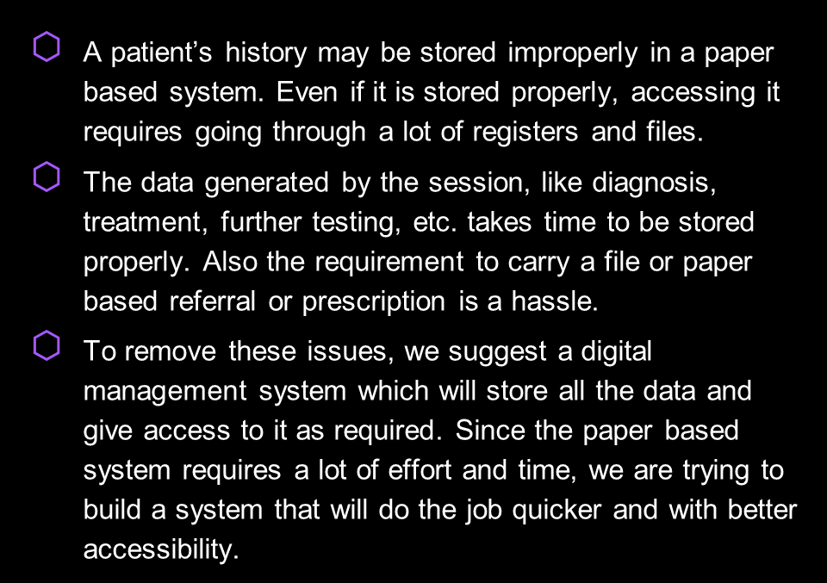

Introduction

Slide 5
2.
Problem Statement

Slide 6




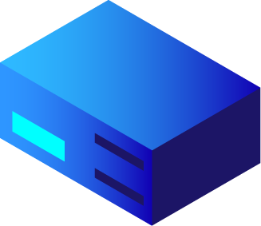




Problem Statement
Create an application to facilitate information storage and sharing between doctor and patient over cloud. This information includes prescriptions, referrals, patient’s medical history etc. The information exchange must occur even without internet connectivity.

Slide 7
3. Objective

Slide 8
Objective
An application that provides the doctor access to the patient’s medical history as required.
An application that also allows doctor to store and share diagnosis, give prescriptions or referrals online
Allowing this information sharing over cloud when internet is available and over QR codes when they are having connectivity issues .
Making the process seamless, quick, and allowing the transactions to be as paperless and contactless as possible..

Slide 9
4. Related Background

Slide 10
Related Background
APPification of Hospital Healthcare and Data Management using QR code.
The research presents how QR code system can be included in healthcare system.
An Open Source Private Cloud Solution for Rural Healthcare.
The paper presented architecture of using Private Cloud to improve the efficiency of healthcare delivery using simple procedures that can complement advanced techniques such as using automated diagnosis and telemedicine.
Case Study on Software as a Service (SaaS) Based Emergency Healthcare in India.
The results provide Software as a service for human beings in emergency situations and distributed image processing tool for medical practitioners.

Slide 11
5. Expected Outcome

Slide 12

Expected Outcome
We will have an application that eases the way for exchange of prescriptions, referrals, medical history etc. that can happen over cloud and over QR codes where internet connectivity is an issue.
The patient will benefit from the storage of diagnosis and prescription allowing them to not worry about storing their history or files properly since all that information will be available on cloud.
The doctor will be able to provide better treatment to the patient by having their history on hand helping them both.

Slide 13
6. Tools & Technology

Slide 14





Technology
Mongo DB
Cross-platform Document-Oriented Database
1
Express JS
Back-End Framework
2
React and ReactNative
Front-End Framework for website and for mobile application.
Node Js.
JS Runtime Environment.
3
4

Slide 15



Tools

Slide 16
7. Software and Hardware Requirements

Slide 17
Software Requirements
End user
Any operating system with latest chrome browser support.
Android mobile phone
Developers
Android Studio
Visual Studio Code

Slide 18

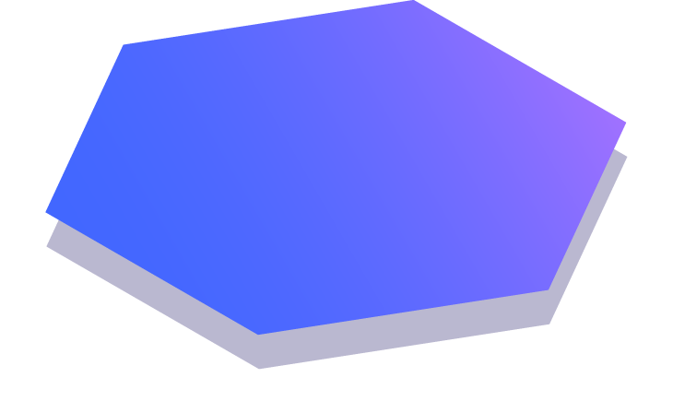
Hardware Requirements
Developer
Computer - 2GHz minimum, multi-core processor
Memory(RAM) - At least 8 GB, preferably higher, and commensurate with concurrent usage
Hard disk space - At least 30GB

Slide 19
8. Methodology (Modules)

Slide 20

Modules
Login Module and Logout Module.
Doctor’s Module
Patients list
Prescription for the patient.
QR code reader/writer.

Slide 21
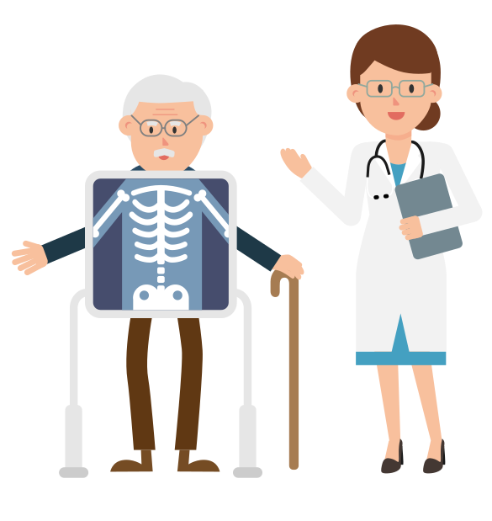
Modules
Patient Module
Insert the diseases.
QR code reader/writer.
Referrals and prescriptions

Slide 22
9. Design/Diagrams

Slide 23
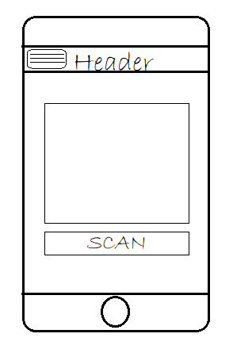
Mobile App View
The view get changed with the final output of the application.

Slide 24
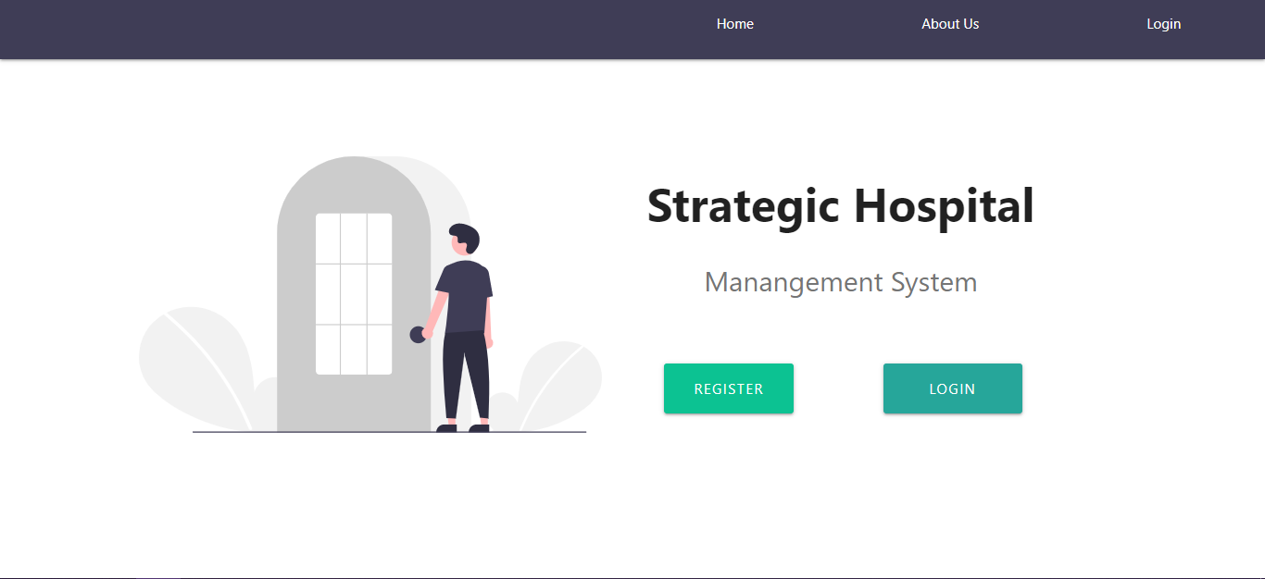
Desktop View

Slide 25
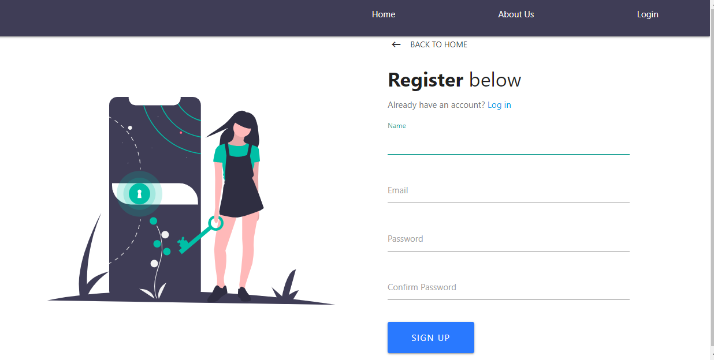
Desktop View

Slide 26
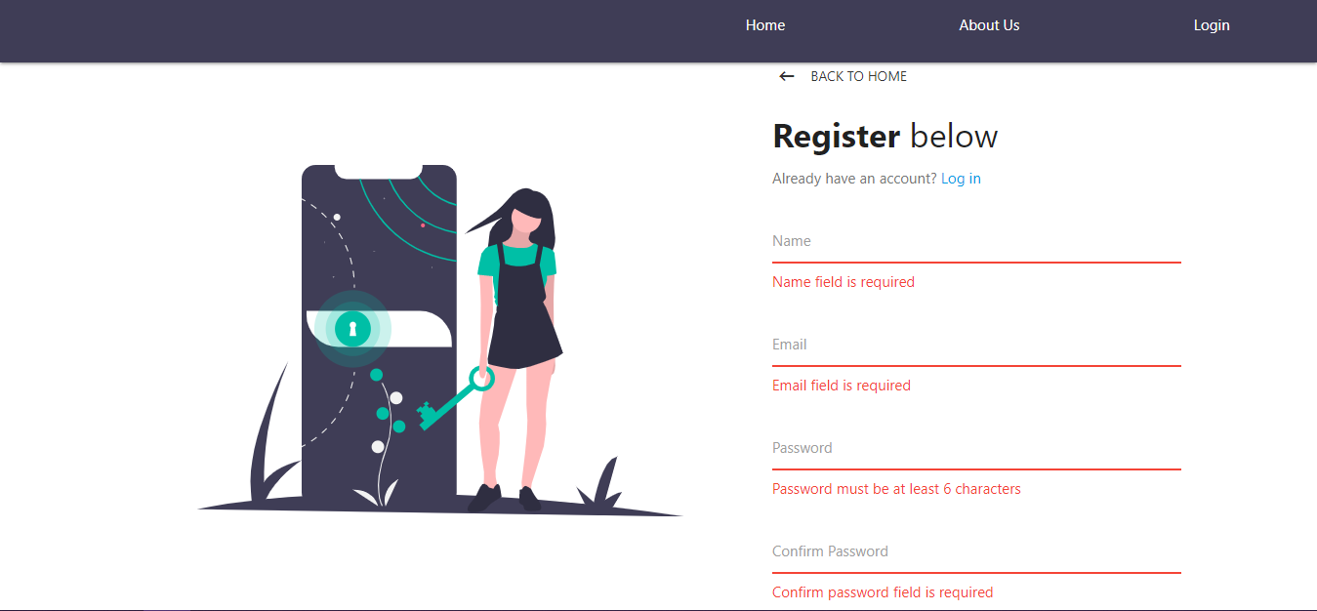
Desktop View

Slide 27
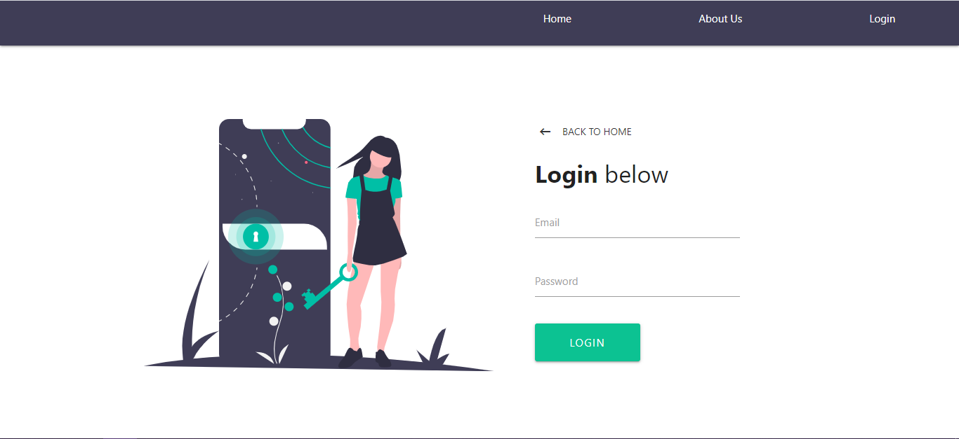
Desktop View

Slide 28
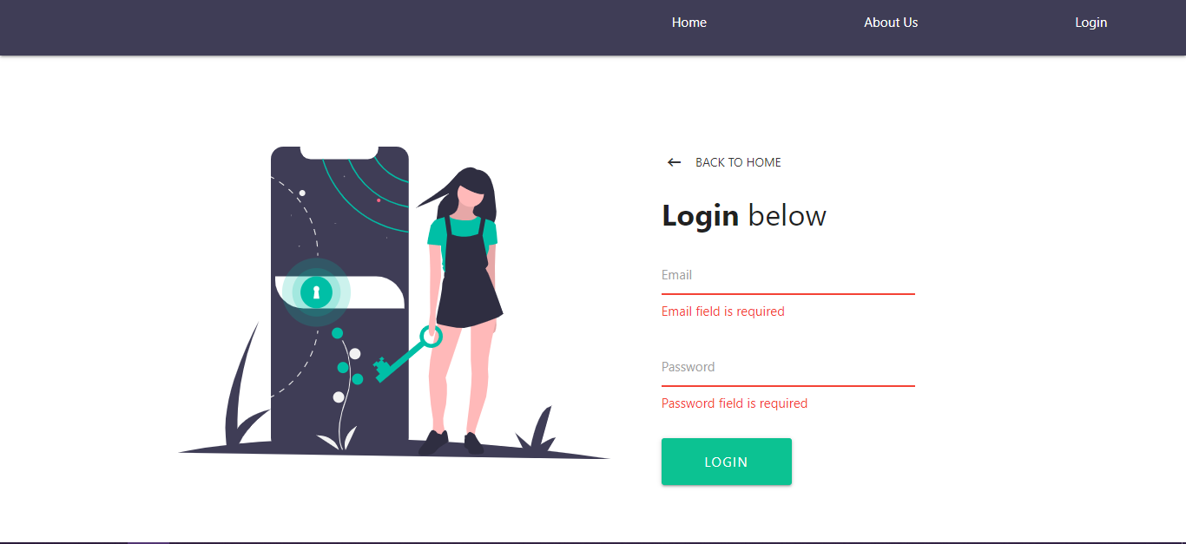
Desktop View

Slide 29

Desktop View

Slide 30
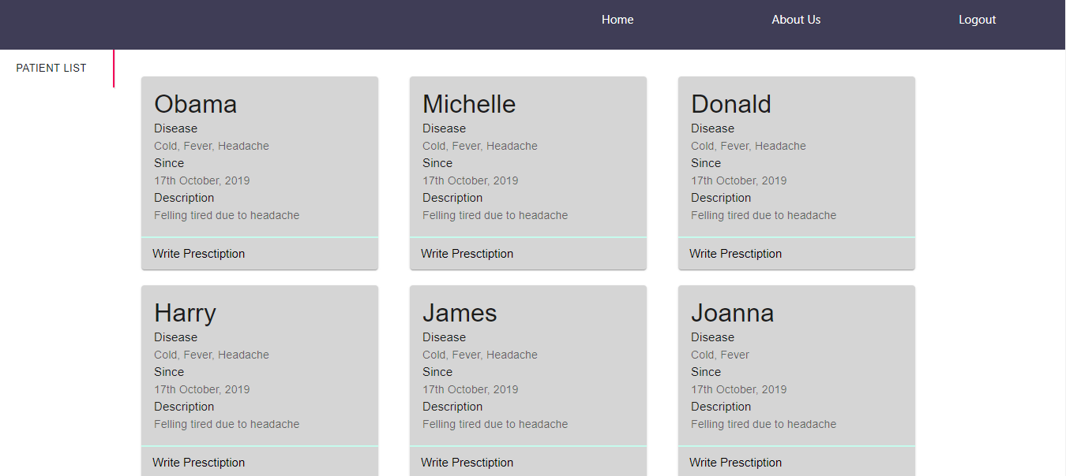
Desktop View

Slide 31
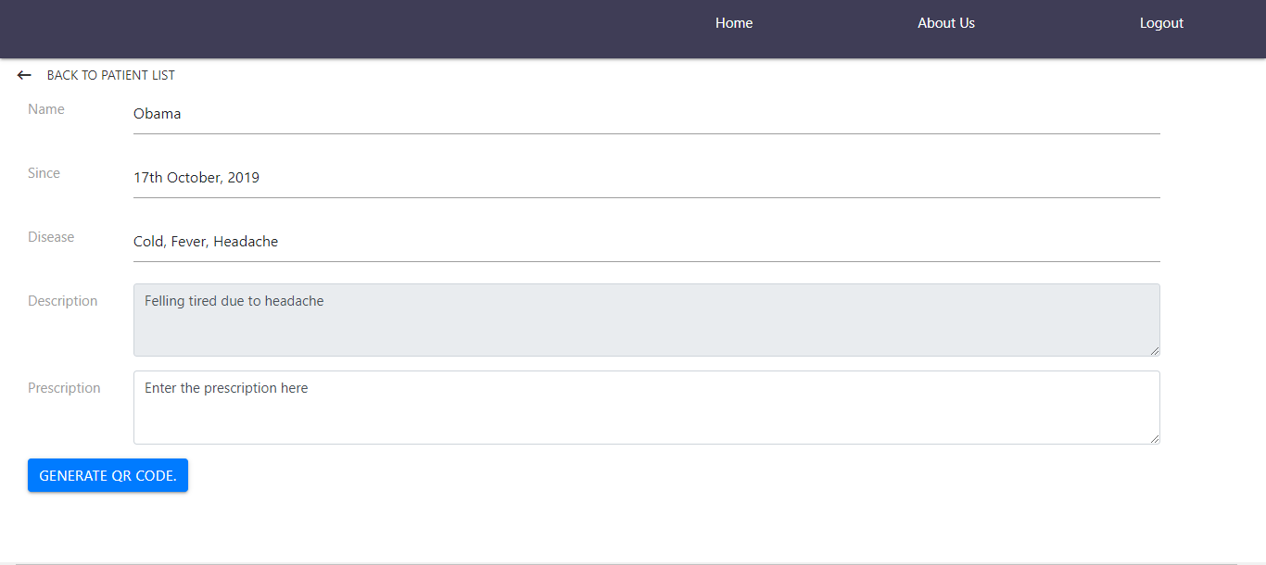
Desktop View

Slide 32
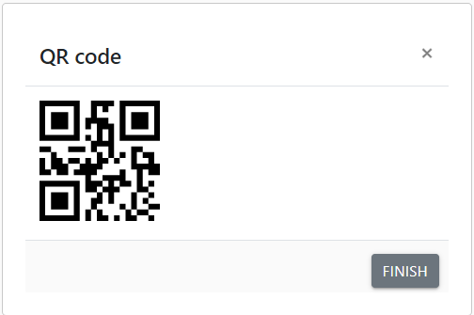
Desktop View

Slide 33
10. Flow chart & Algorithm

Slide 34


Flowchart (Login Module)
For better view of the flow chart visit:
Landing page
https://lucid.app/invitations/accept/0661da0c-21c4-46d5-9c09-82be01918867
Dashboard
https://lucid.app/invitations/accept/0f90eb93-434e-46aa-b524-64c2f79f33d3
Prescription
https://lucid.app/invitations/accept/5bd1cf46-97bc-40b6-b4a6-27ceb756da45

Slide 35
11. Timeline

Slide 36
Time line
Requirement Gathering
July(2020)
August(2020)
September(2020)
October(2020)
14th
21st
28th
14th
16th
23rd
14th
21st
30th
5th
12th
19th
Research Paper
Defining Problem Statement
Login and Logout Module
Doctor’s and Patient Module(FrontEnd)
Doctor’s and Patient Modile(Backend)

Slide 37
12. Conclusion

Slide 38
Conclusion
As per our problem statement, to create the application that eases the way for sharing information between a doctor and a patient, we will create an application that is easy to use and works as shown in the flow charts and can be used by anyone with a browser with internet or an android phone. We hope this will resolve the problem of data storage and access leading to better treatments for people.

Slide 39
13. References

Slide 40
References
P. Mersini, E. Sakkopoulos and A. Tsakalidis, "APPification of hospital healthcare and data management using QRcodes," IISA 2013, Piraeus, 2013, pp. 1-6, doi: 10.1109/IISA.2013.6623716.
M. D. Lakshmi and J. P. M. Dhas, "An open source private cloud solution for rural healthcare," 2011 International Conference on Signal Processing, Communication, Computing and Networking Technologies, Thuckafay, 2011, pp. 670-674, doi: 10.1109/ICSCCN.2011.6024635.
Nagarajan, Dr.Karthikeyan & Sukanesh, R. (2012). Case Study on Software as a Service (SaaS) Based Emergency Healthcare in India. European Journal of Scientific Research. 69.

Slide 41
Thanks!
Any questions?
You can find us at:
namrata.cba1737@ict.gnu.ac.in
priya.cba1749@ict.gnu.ac.in

